Slide 1



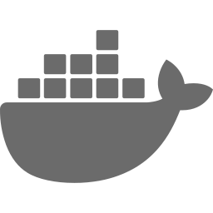
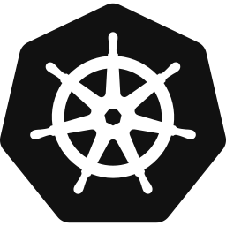


M.Tech | Advanced Software Engineering
SUBMITTED BY
Balla Bharath Venkat (2610603)
Rohit Bhure (2610611)
Microservices Based
Development Using DevOps
PROGRAM
Master of Technology (M.Tech)
DEPARTMENT
Information Architecture &
Software Engineering
SUBJECT
Advanced Software Engineering
GUIDE
Dr. Ugrasen Suman
INSTITUTION
School of CS & IT, DAVV, Indore
SESSION
2026-2027
Notes:
Hum apna topic introduce karenge: Microservices ko DevOps ke saath kaise banate aur chalate hain. Dono research papers par based hai.

Slide 2
Monolithic vs Microservices: The Idea
Monolithic
Microservices
ONE APP
Service A
Service B
Service C
UI
Logic
Data
DB
DB
DB
One DB
Small services, each with its own database
One change = redeploy everything
Cannot scale just one part
Tightly coupled, one tech stack
Deploy each service on its own
Scale only what is needed
Each team picks its own tech
Microservices Based Development Using DevOps | IA&SE — DAVV | 2026-27
2 / 16
Notes:
Pehle monolith samjhao: sab kuch ek hi bada app, ek hi database. Ek chhota change bhi poora app dobara deploy karwata hai. Microservices mein app chhote-chhote independent services mein tut jata hai. Backtory ka example batao jo paper mein hai.

Slide 3


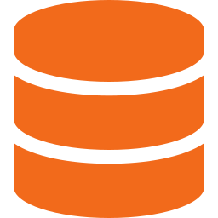



Microservices: Key Characteristics
Microservices = an app built as many small services. Each does one business job and is deployed on its own. (Balalaie et al., 2016)
One Job per Service
Independent Deployment
Own Database
e.g., User Login, Orders, Payments
Release one service without touching others
No shared schema between services
Any Technology
Fault Isolation
Light Communication
Java, Node.js, Python, Go — team’s choice
One service fails, the system keeps running
REST APIs or message queues (Kafka, RabbitMQ)
Made possible by: Docker • Kubernetes • CI/CD • Cloud
Microservices Based Development Using DevOps | IA&SE — DAVV | 2026-27
3 / 16
Notes:
Definition simple rakho: chhote services, har ek ek kaam karta hai aur alag deploy hota hai. Phir 6 cards ek-ek line mein bolo. Last mein batao ki Docker, Kubernetes, CI/CD ki wajah se yeh practical bana.

Slide 4
Monolithic vs. Microservices
 | Monolithic | Microservices
Deployment | One big package | Many small packages
Scaling | Scale the whole app | Scale only one service
Technology | One stack | Best tool per service
Team | Large, separate teams | Small DevOps teams
Failure | One bug can crash all | Failure stays inside one service
Database | One shared database | Database per service
Microservices Based Development Using DevOps | IA&SE — DAVV | 2026-27
4 / 16
Notes:
Table row by row bolo. Sabse important: deployment, scaling aur failure. Balalaie ki team ne Backtory migration mein yeh sab khud experience kiya.

Slide 5


Microservices Architecture
SUPPORTING INFRASTRUCTURE
Client
Web / Mobile
API Gateway
Zuul / Kong
Load Balancer
Ribbon
Service Discovery
Eureka
Config Server
Spring Cloud
User Service
Order Service
Payment Service
Product Service
Notification Service
User DB
Order DB
Payment DB
Product DB
Notification DB
MONITORING & OBSERVABILITY
ELK Stack
Logs
Zipkin
Tracing
Prometheus + Grafana
Metrics
Microservices Based Development Using DevOps | IA&SE — DAVV | 2026-27
5 / 16
Notes:
Flow samjhao: Client request API Gateway par aati hai, gateway sahi service ko bhejta hai, har service ka apna database hai. Upar side mein load balancer, service discovery aur config server madad karte hain. Neeche monitoring sab par nazar rakhti hai.

Slide 6
DevOps and Why Microservices Need It
Why Microservices need DevOps
DevOps = Dev and Ops teams working together, with automation, to deliver software fast and continuously. (Bass, Weber & Zhu, 2015)
1
Many services = many pipelines
CI
Continuous Integration
CD
Continuous Delivery
One CI/CD pipeline per service
Merge often, test automatically
Always ready to release
2
Same environment everywhere
Docker containers
CM
Continuous Monitoring
IaC
Infrastructure as Code
3
Run and scale automatically
Watch production in real time
Environments written as code
Kubernetes + monitoring
DevOps is a culture shift, not just a tool.
Microservices Based Development Using DevOps | IA&SE — DAVV | 2026-27
6 / 16
Notes:
DevOps ek culture hai jisme Dev aur Ops saath kaam karte hain. Chaar practices: CI, CD, CM, IaC. Phir right side par batao ki microservices ko DevOps kyun chahiye: bahut saare services = bahut saare pipelines, isliye automation zaroori hai.

Slide 7
Microservices Development Lifecycle
1
Plan & Design
2
Code & Build
3
CI Pipeline
4
Containerize
Define services and API contracts
Write code, build, push to GitLab
Jenkins runs build and tests
Docker image goes to registry
8
Feedback
7
Monitor
6
Production Deploy
5
CD — Staging
Alerts become new tasks; repeat
ELK and Zipkin watch the system
Rolling / canary release, rollback if needed
Deploy and test on Kubernetes
↺ Continuous Feedback Loop ↺
Microservices Based Development Using DevOps | IA&SE — DAVV | 2026-27
7 / 16
Notes:
Yeh poora loop hai: plan se lekar monitoring tak, aur phir feedback se dobara plan. Har step ek line mein samjhao. Number 1 se 8 follow karo, neeche wali row right se left chalti hai.

Slide 8









Version Control (Git) and Continuous Integration
One Git repository per service. Code is merged to main only after CI passes. Backtory used self-hosted GitLab.
CI pipeline: every commit is built and tested automatically
Q
Commit
Trigger
Build
Inspect
Unit Test
Integration
Security
Publish
GitLab
Jenkins
Maven / Gradle
SonarQube
Fortify
Artifactory
Merge small changes often — avoids big integration conflicts
Backtory: one CI job per microservice
Microservices Based Development Using DevOps | IA&SE — DAVV | 2026-27
8 / 16
Notes:
Pehle Git: har service ka apna repository. Code tabhi main mein jata hai jab CI pass ho. Phir CI pipeline ke 8 steps left to right bolo. Backtory mein Jenkins aur GitLab use hua; shared integration tests ki jagah contract tests lagaye.

Slide 9

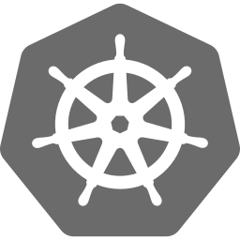
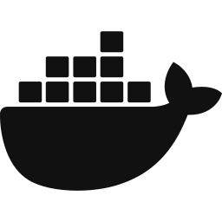
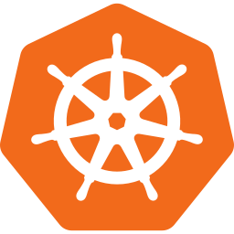
CI/CD Pipeline: Old vs New
Continuous Delivery: every passing build is ready to release
Continuous Deployment: every passing build goes live automatically
(a) Old: one pipeline for the whole monolith
GitLab
Fetch
Jenkins
Build
Jenkins
Build
Jenkins
Test
Docker
Registry
K8s
Deploy
(b) New: separate pipeline for each microservice
Service 1
GitLab
Fetch
Jenkins
Build
Jenkins
Test
Docker
Registry
K8s
Deploy
Service 2
GitLab
Fetch
Jenkins
Build
Jenkins
Test
Docker
Registry
K8s
Deploy
Service N
GitLab
Fetch
Jenkins
Build
Jenkins
Test
Docker
Registry
K8s
Deploy
Key difference: each service deploys independently — no other service is affected (Balalaie et al., 2016).
Microservices Based Development Using DevOps | IA&SE — DAVV | 2026-27
9 / 16
Notes:
Upar CD ke do meaning: Delivery matlab release ke liye ready, Deployment matlab seedha production. Phir diagram: purane monolith mein ek hi pipeline thi, ab har microservice ka apna alag pipeline hai, isliye ek service deploy karne se dusri service nahi chhuti.

Slide 10
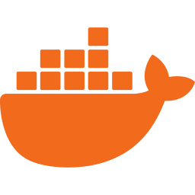
Docker and Kubernetes
Docker — package it
Kubernetes — run it
Service A
Service B
Service C
CLUSTER
Deployment
Pod
Pod
Pod
Docker Engine
Host Operating System
Pod = running container
Service (stable address)
Infrastructure
Packs a service + its dependencies
Same behaviour in dev, test, production
Docker Compose: start all services with one file
Deploys containers automatically
Scales up/down and heals failures
Used with CoreOS in Backtory
Both papers: Docker + Kubernetes (Balalaie et al.; Xuan et al.)
Microservices Based Development Using DevOps | IA&SE — DAVV | 2026-27
10 / 16
Notes:
Docker: service aur uski saari dependencies ek container mein pack hoti hain, to har jagah same chalta hai. Kubernetes: bahut saare containers ko automatically deploy, scale aur heal karta hai. Dono papers mein yahi stack use hua.

Slide 11
API Gateway and Service Communication
API Gateway (Zuul)
Single entry point: routing, authentication
Service A
REST / gRPC
Direct calls between services (synchronous)
Service B
Message Queue
RabbitMQ / Kafka — async, loosely coupled
Client
API Gateway
(Zuul)
Service Discovery (Eureka)
Finds where each service is running
Service C
Service Discovery
(Eureka)
Circuit Breaker (Hystrix)
Fails fast so one failure does not spread
Container IPs change, so services use discovery instead of fixed addresses.
Microservices Based Development Using DevOps | IA&SE — DAVV | 2026-27
11 / 16
Notes:
API Gateway sabka single entry point hai. Services aapas mein REST se seedha baat kar sakti hain ya message queue se. Service Discovery batata hai kaun sa service kahan hai, aur Circuit Breaker failure ko failne se rokta hai.

Slide 12


Monitoring, Logging and Tracing
EACH SERVICE CONTAINER
MONITORING SERVER
Collectd
Metrics
Elasticsearch
Store
Kibana
Dashboards
Logstash
Logs
Zipkin
Request tracing
Prometheus
Metrics
Per-service monitoring
Each service has its own metrics and logs
Distributed tracing
Zipkin shows which service is slow
Microservices Based Development Using DevOps | IA&SE — DAVV | 2026-27
12 / 16
Notes:
Har microservice container se metrics aur logs monitoring server ko jate hain. Elasticsearch store karta hai, Kibana dashboard dikhata hai. Zipkin batata hai ek request kis kis service se guzri. Backtory mein anomaly detection bhi lagayi.

Slide 13


Testing and Security
Testing
Security (DevSecOps)
End-to-End
Full user journey (few, slow)
Security is checked at every stage, not only at the end.
1
Plan Security rules in the design
Integration
Services working together
2
CI Static code scan (Fortify)
Contract Tests
Each service tested alone (Backtory)
3
CD Black-box scan (Appscan)
Unit Tests
Fast, run on every commit
4
Production Monitor and patch continuously
Tools (Xuan et al.)
Fortify
Appscan
JMeter
Microservice risks
Many APIs • service-to-service trust • secrets • image scanning
Microservices Based Development Using DevOps | IA&SE — DAVV | 2026-27
13 / 16
Notes:
Left: testing pyramid, upar kam aur slow tests, neeche zyada aur fast. Backtory ne contract tests use kiye. State Grid ne Fortify, Appscan aur JMeter use kiye. Right: DevSecOps matlab security har stage mein, end mein nahi.

Slide 14
Deployment Strategies
Blue-Green
Rolling
Canary
Blue (live)
Green (new)
v1
v1
v1
Traffic
v1
v2
Router
v1
v2
v1
90%
10%
v1
v2
v2
v2
v2
v1
v2
v1
v2
Two identical environments
Switch traffic in one step
Instant rollback
Replace old pods gradually
v1 and v2 run together
Kubernetes default
Small % of traffic to new version
Watch errors, then increase
Safest for risky changes
Microservices Based Development Using DevOps | IA&SE — DAVV | 2026-27
14 / 16
Notes:
Teen tarike: Blue-Green mein do environment, ek click mein switch. Rolling mein dheere dheere purane pods naye se badalte hain. Canary mein pehle thoda sa traffic naye version ko dete hain. Safest canary hai.

Slide 15
Challenges and Best Practices
Challenges
Best Practices
Distributed complexity
Network failures, latency
Design by business capability
Domain-Driven Design
Local dev setup
Many services to run
Docker Compose
Run everything locally
Service contracts
Small API change can break others
Consumer-driven contracts
Test each service alone
Skills gap
Needs distributed-systems know-how
Cross-functional teams
One team per service
Operations load
Many deployments and dashboards
Automate + monitor
CI/CD, ELK, Zipkin from day one
Microservices Based Development Using DevOps | IA&SE — DAVV | 2026-27
15 / 16
Notes:
Left: kya mushkilein aati hain, right: unka solution ya best practice. Honest raho: microservices silver bullet nahi hai, complexity badhti hai, lekin sahi practices se manage hoti hai.

Slide 16
References
[1]
Microservice Publishing Technology Based on DevOps Architecture
IEEE ITNEC(ISSN:2693-3128)
[2]
Microservices Architecture Enables DevOps
Microservices Based Development Using DevOps | IA&SE — DAVV | 2026-27
16 / 16
Notes:
References sirf dikhane ke liye hain; zarurat ho to paper ka naam bolo.

Slide 17
THANK YOU
Questions & Discussion
Balla Bharath Venkat (2610603) | Rohit Bhure (2610611)
M.Tech — Information Architecture & Software Engineering
School of CS & IT, DAVV, Indore | Advanced Software Engineering
Guide: Dr. Ugrasen Suman | Session 2026-2027
Notes:
Thank you bolo aur questions ke liye invite karo.

